Slide 1
Bookworm LMS A Learning Management System in Python
Abigail, jesus, kellen, kevin, soumya

Slide 2
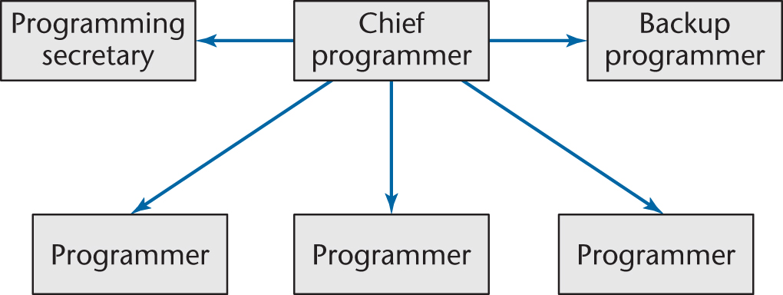
Project Team Overview
Team Organization: Chief Programmer - Kellen

Slide 3
Project Programming Details
Language: Python 3
IDE: PyCharm
Data Storage Method: Python binary blobs with pickle
GUI build with TKInter
Development Lifecycle: Rapid Prototyping

Slide 4
Project Task Details
Documentation – Soumya/Kevin
Login/Permissions - Jesus/Kellen
Storage/Retrieval - Kellen
GUI – Soumya/Jesus
Data Ops – Modification, GPA calc, etc. - Kellen
Testing – Abilgail, Kellen
Presentation - Everyone

Slide 5
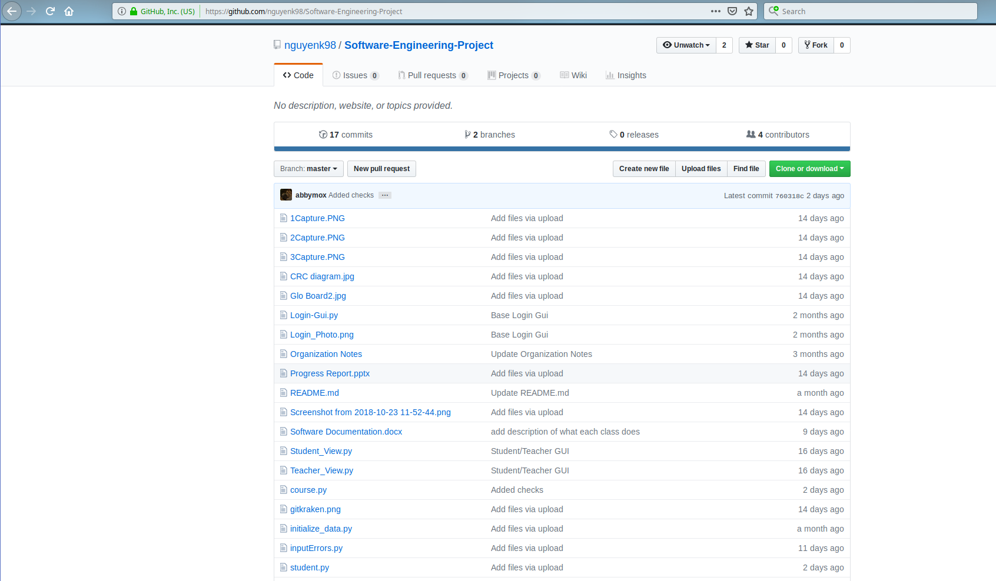
GitHub Repo
https://github.com/nguyenk98/Software-Engineering-Project

Slide 6

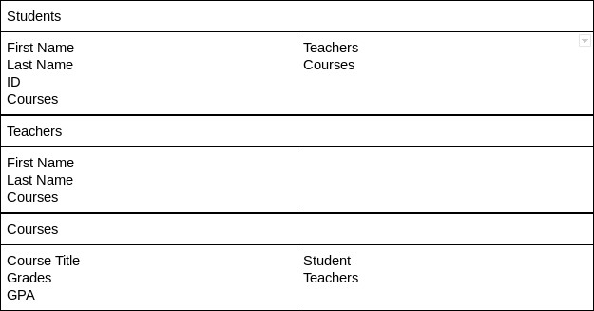



CRC Cards

Slide 7
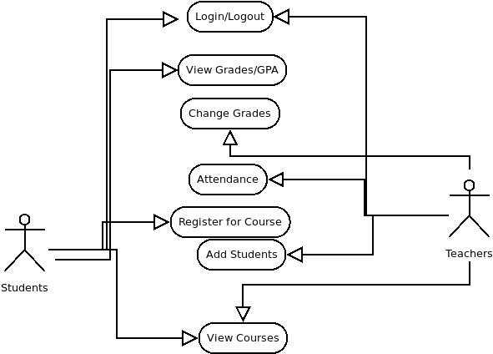
Use Case Diagram

Slide 8
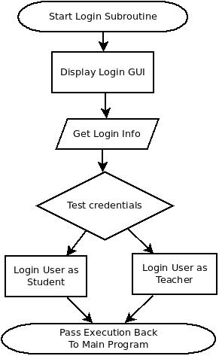
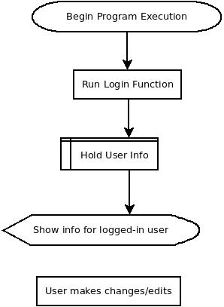
Flow Charts – Login and Overview

Slide 9
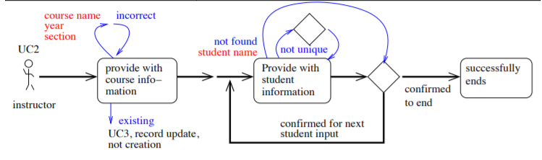
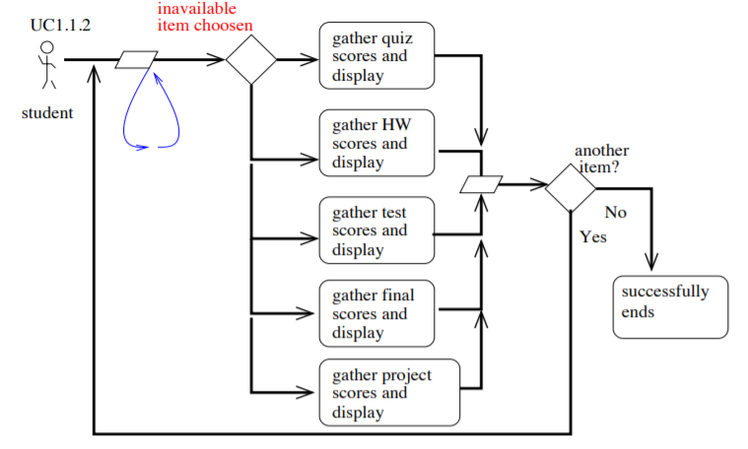
Flow Charts Student/Teacher

Slide 10
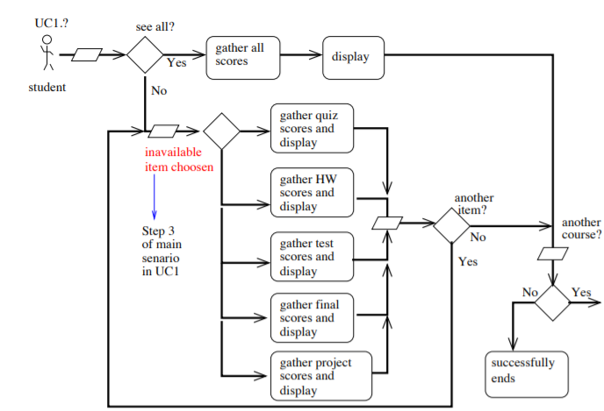
Flow Chart - Student

Slide 11
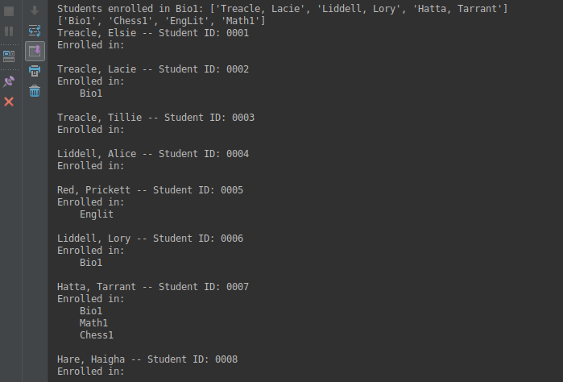
Rapid Prototype

Slide 12
Testing Details
Extra code for input validation
Ensuring modules work together properly

Slide 13
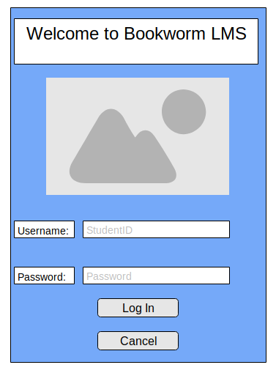
GUI mockup – Login GUI

Slide 14
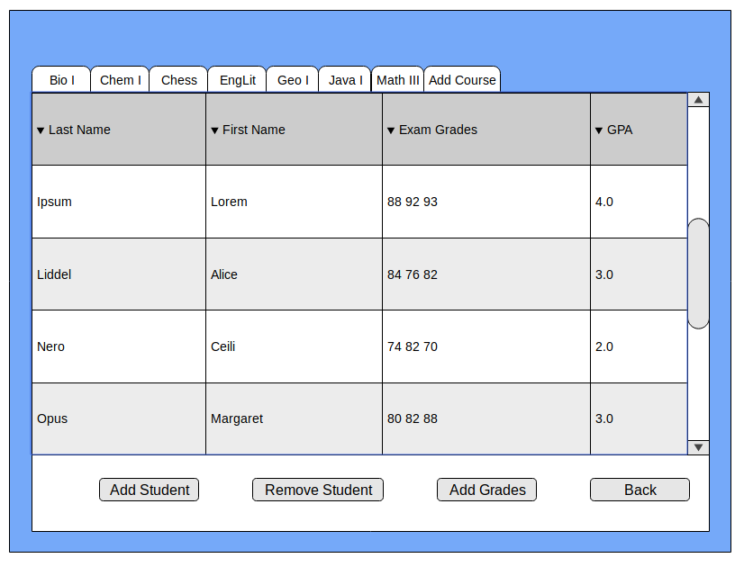
GUI mockups – Teacher View

Slide 15
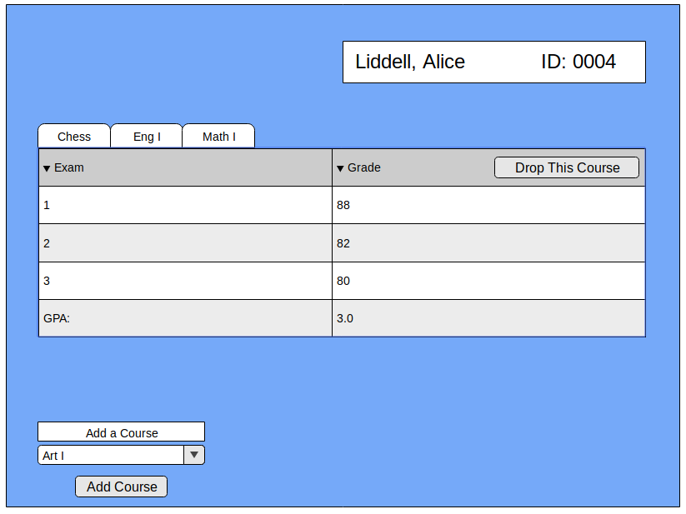
GUI mockups – Student View

Slide 16
GUI Roadblocks
Team member assigned to GUI did not commit code
GUI mockups made for project planning, but implementing it in code caused problems

Slide 17
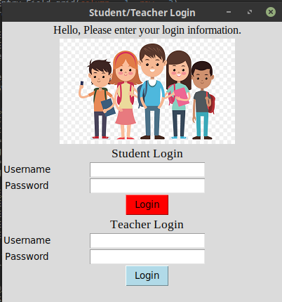
GUI Progress
Login Screen executes properly

Slide 18
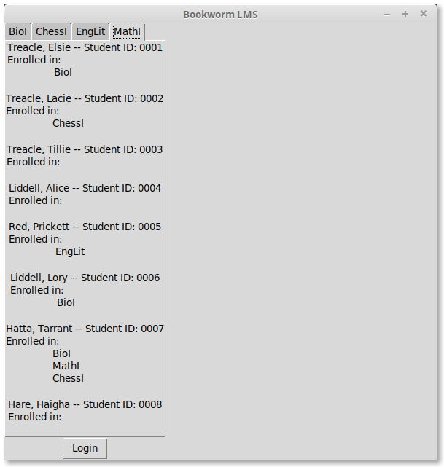
GUI Progress – Teacher View

